Slide 1
Prompt Engineering
CSE 705 Recent Advances in Deep Learning & Reinforcement Learning
Presenter: Rahul Yadav

Slide 2
What is a Prompt?
Prompt is a specific input or instruction given to guide the model's output generation, serving as initial context or a guiding signal for the desired task.
Effective prompt design is essential for leveraging language models and achieving desired results.
An effective prompt should be specific, simple, and concise This is where prompt engineering comes into play…

Slide 3
What is a Prompt Engineering?
Prompt engineering is a novel discipline that focuses on developing and optimizing prompts for language models (LMs). Encompassing a wide range of skills and techniques for interacting and developing with LLMs.
It plays a crucial role safeguarding the response generated from LLMs by putting restrictions and rules using domain knowledge and external tools. Personal Opinion:
This is the way to properly utilize the power of LLMs in the real-world applications, for example web searches

Slide 4
Example
Traditional Web Query: Query + Filter → Search Engine → Top Ranked Results
Example: Query: What are employee benefits? Filter: site: www.buffalo.edu Response: Top Ranked Web Pages Query with Prompt to Large Language Models(like ChatGPT): Query + Prompt → LLM → Generated Responses Example: What are employee benefits? Prompt: You are an HR employee at Suny Buffalo, only response according to the information mention in the employee documents
Response: <Respective Generated Response>

Slide 5
Elements of Prompt
Instruction - a specific task or instruction you want the model to perform
Context - external information or additional context that can steer the model to better responses
Input Data - the input or question that we are interested to find a response for Output
Indicator - the type or format of the output.

Slide 6
Popular Prompting Techniques
Zero-Shot Prompting
Few-shot Prompting
Chain-of-Thought (CoT) Prompting
Self-Consistency
Generate Knowledge Prompting
Tree of Thoughts (ToT)
Prompting examples: https://github.com/dair-ai/Prompt-Engineering-Guide/blob/main/notebooks/pe-lecture.ipynb

Slide 7
Applications
Data Generation
Question Answering
Role based content writing
Image Generation
More relevant retrieval systems
Code Generation
Personal Assistant
LLMs which support prompt templates: https://www.promptingguide.ai/models
(a new one being added daily, existing times ☺)

Slide 8
Other Important Reads
Tools & Libraries: There are various tools which can help in generating accurate prompt for a particular usecase or tools which can help in experimenting with different prompting techniques. Please use the link attached below for more info: https://www.promptingguide.ai/tools
Latest publications in this domain: Prompt engineering has been an active area of research in the last couple of years with lot of interesting paper being published in this field. https://www.promptingguide.ai/papers
Adversarial Prompting: Understand the risks, safety issues with prompt usage for LLMs and deriving methods to mitigate the risks. https://www.promptingguide.ai/risks/adversarial

Slide 9
Demo Application (LLM Based SQL DB Chat Agent With Langchain)

Slide 10
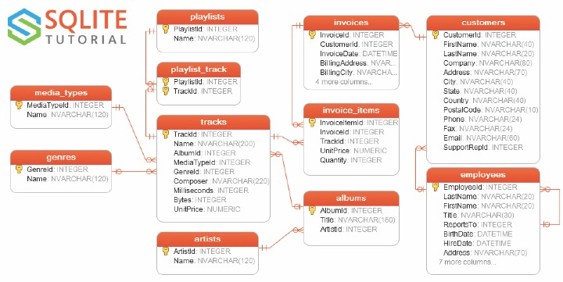
Demo Database ER Diagram

Slide 11
Steps in SQL Agent
Load the complete database schema
Select tables of interest
Describe table structure (DDL scripts of the selected tables)
Give examples of data records (Top k records from a table)
Generating the final SQL query
Query check
Executing the query and retrieving the required result.

Slide 12
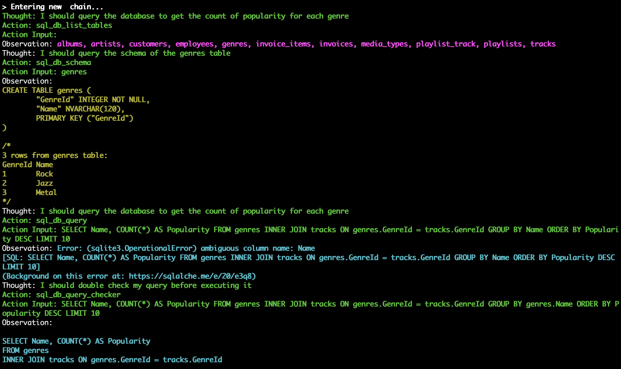
Step1
Step2
Step3
Step4
Step5
Step6 (Query Check)
Step7 (Execute Final Query)

Slide 13
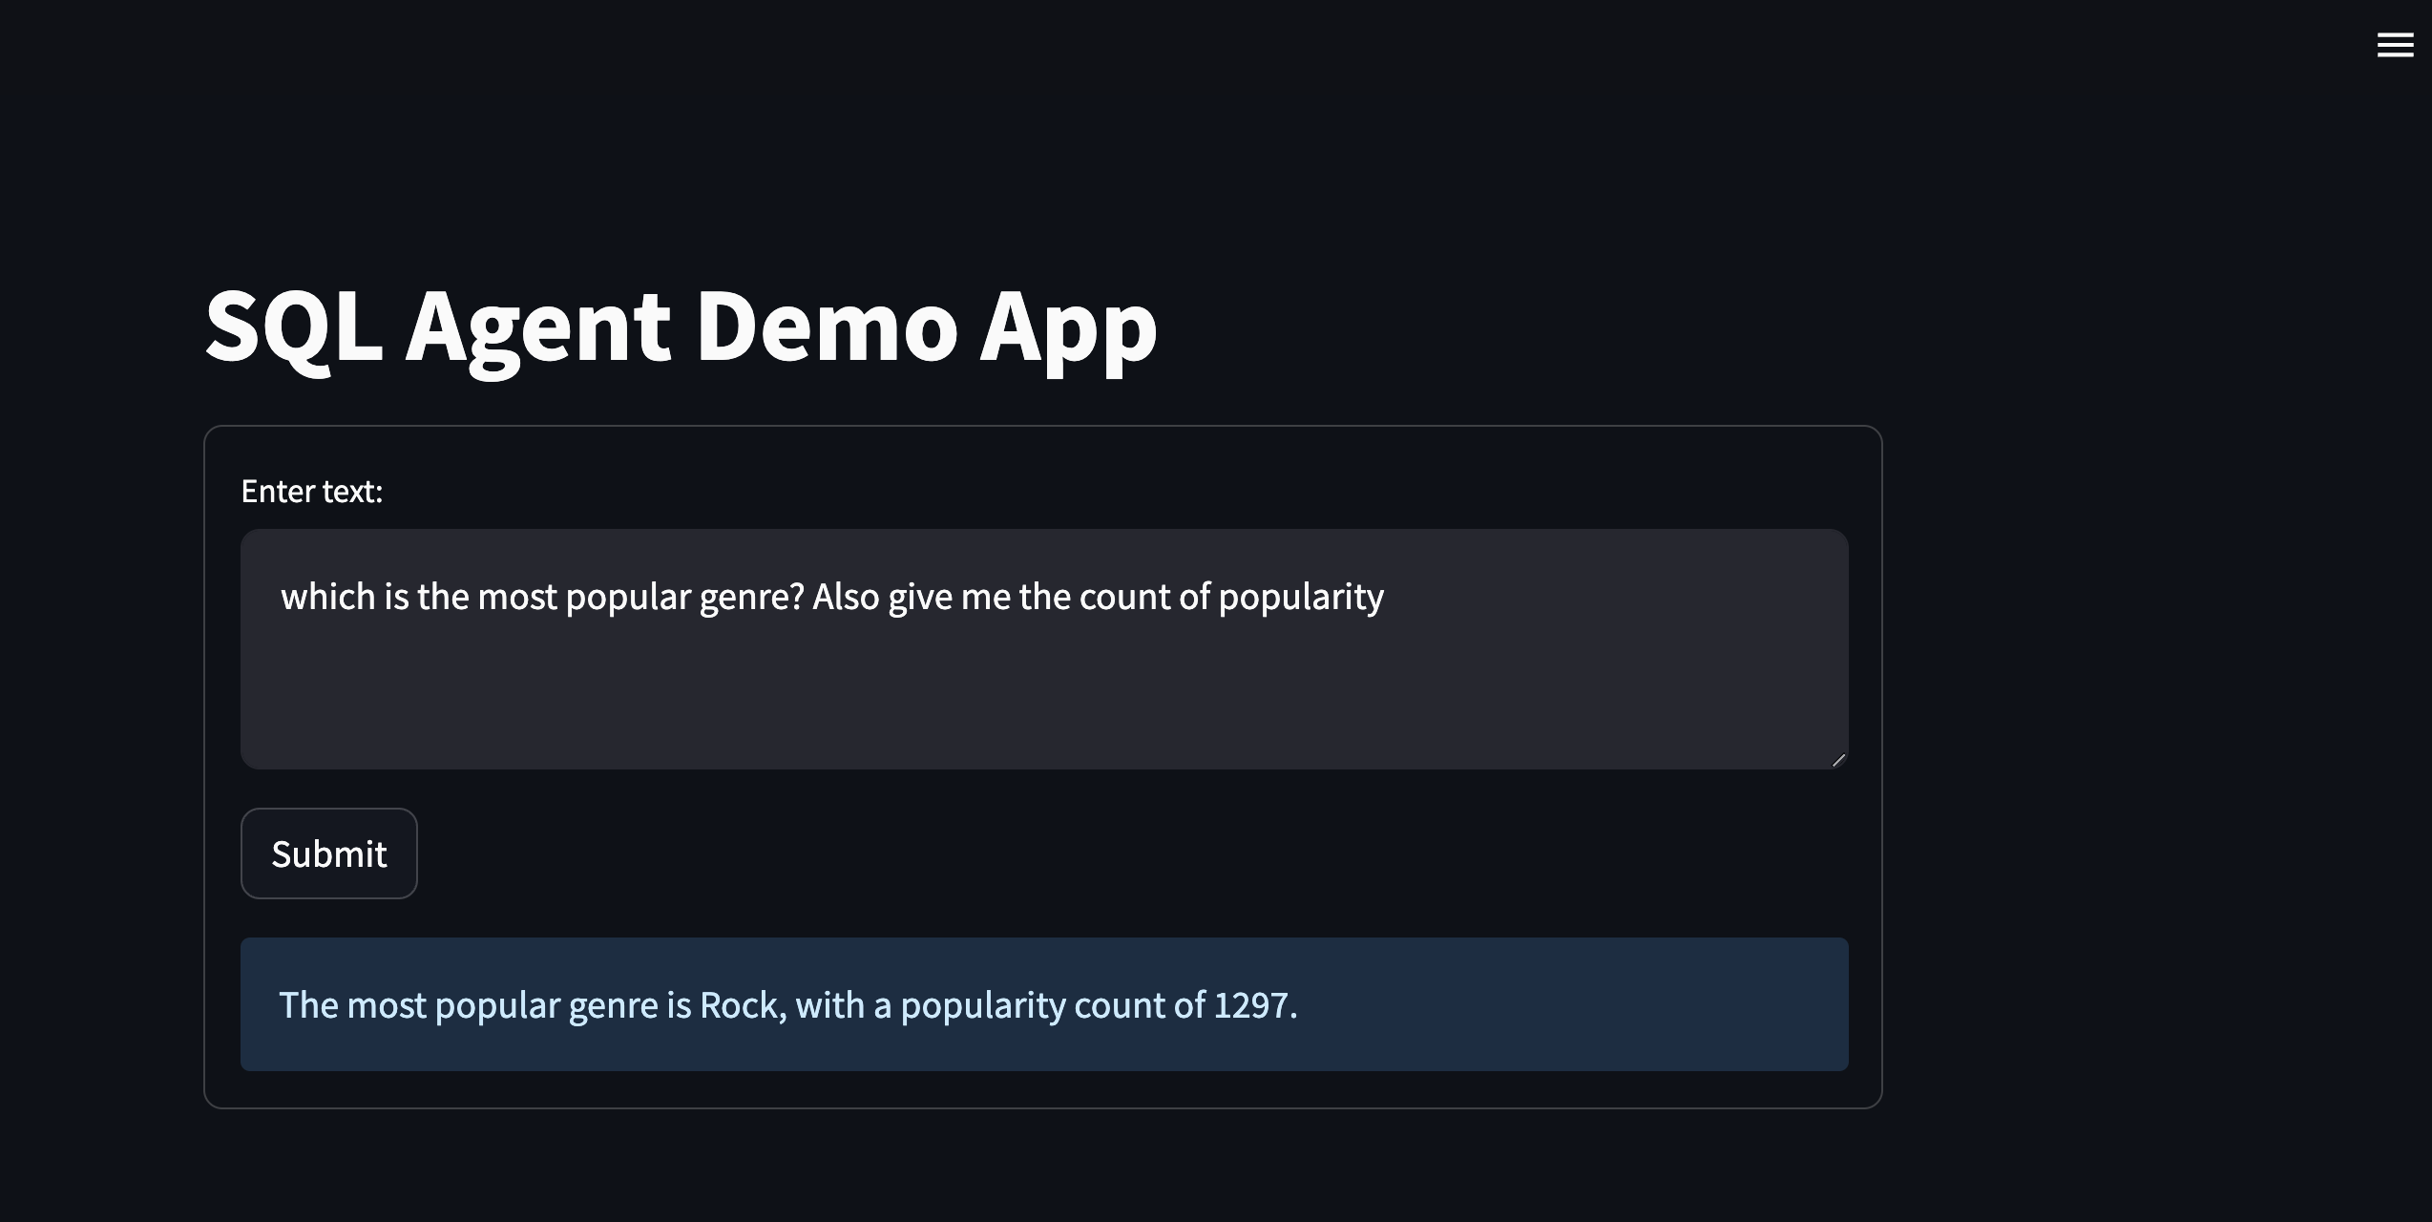
Demo UI

Slide 14
References
https://www.promptingguide.ai/
https://python.langchain.com/docs/get_started/introduction.html
https://openai.com/
https://blog.streamlit.io/langchain-tutorial-1-build-an-llm-powered-app-in-18-lines-of-code/
https://www.sqlitetutorial.net/sqlite-sample-database/
https://blog.langchain.dev/llms-and-sql/
https://heidloff.net/article/importance-of-prompt-engineering/
https://www.nocode.ai/introduction-to-prompt-engineering/
https://fourweekmba.com/prompt-engineering/
https://www.linkedin.com/pulse/3-principles-prompt-engineering-gpt-3-ben-whately/
arXiv:2305.16938

Slide 15
Thank You
Open to Questions

